Slide 1

GLOBAL POWER PLATFORM BOOTCAMP
Organized Globally, Held Locally
@GPPBootcampBLR #GPPBootcampBLR #GlobalPowerPlatformBootcamp

Slide 2

Let’s integrate natural language in your Power BI reports and Ask a question on your data.
Mitul Rana
Platform Specialist, Trelleborg
@mitul_rana
Samik Roy
Senior Developer, Born in the Cloud
@roy_samik
@GPPBootcampBLR #GPPBootcampBLR
#GlobalPowerPlatformBootcamp

Slide 3



Sponsors

Slide 4
Overview of AI in Power BI
Investment areas
Personas and capabilities
End User Insights
AI visualizations
Natural language capabilities
Analyst toolkit
Automated ML
Cognitive services
Agenda

Slide 5



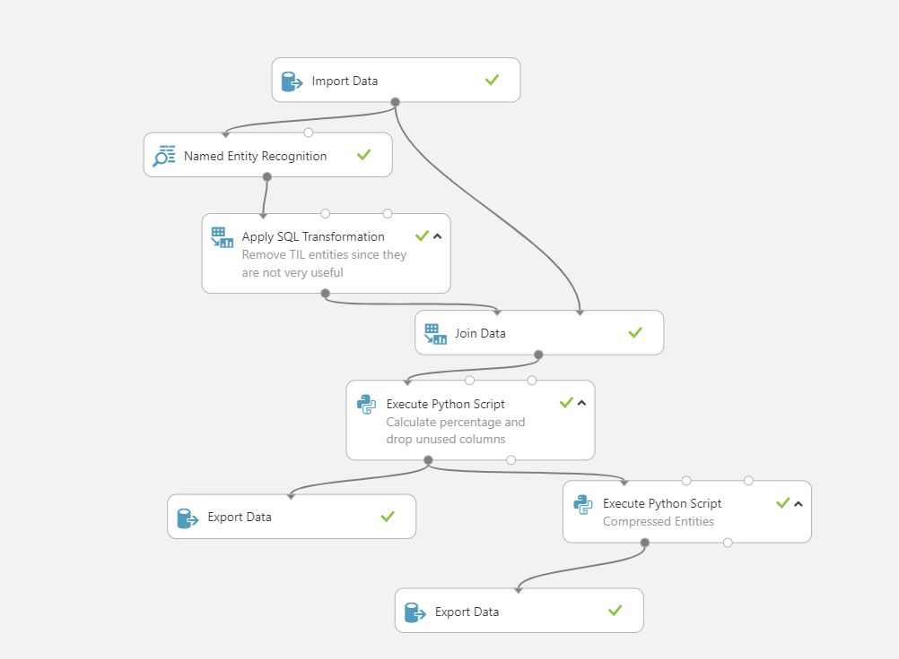
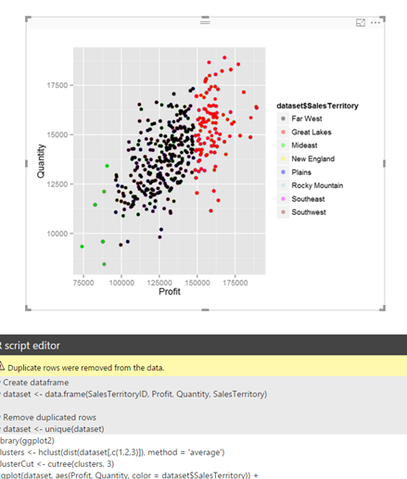
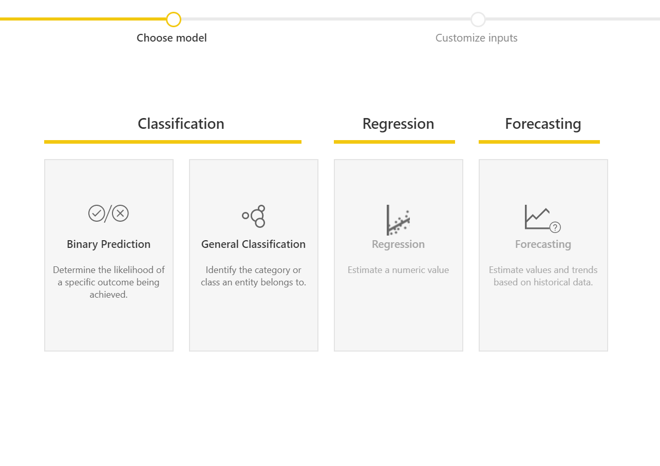
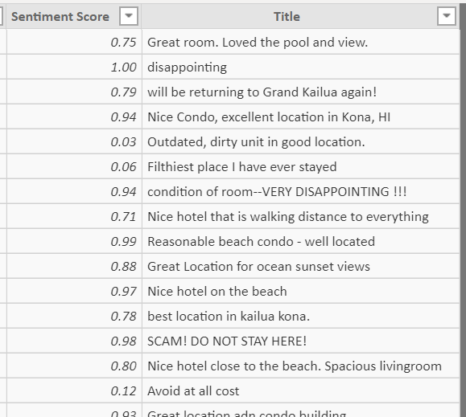
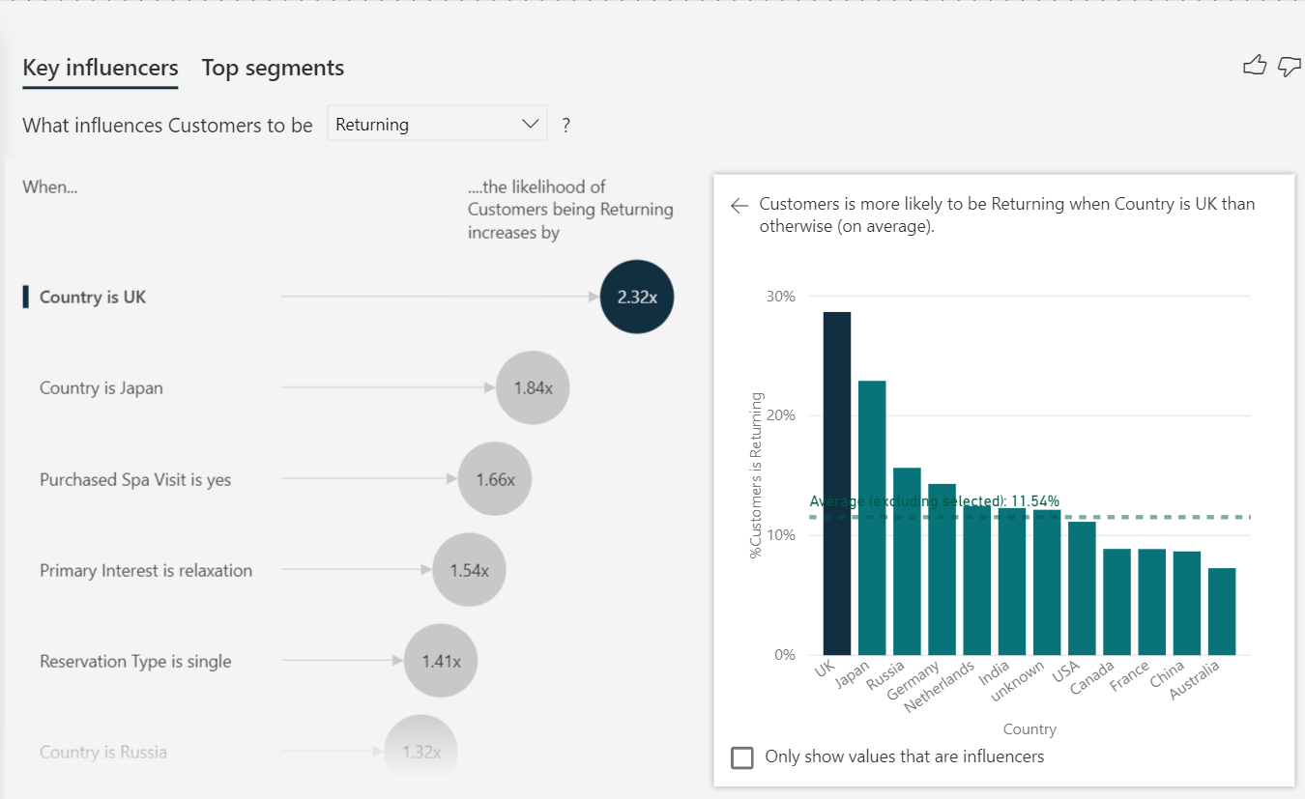
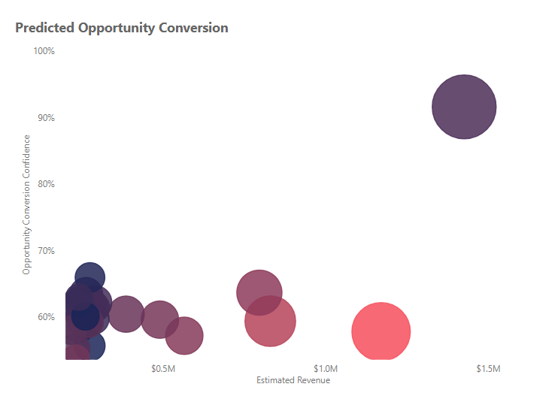
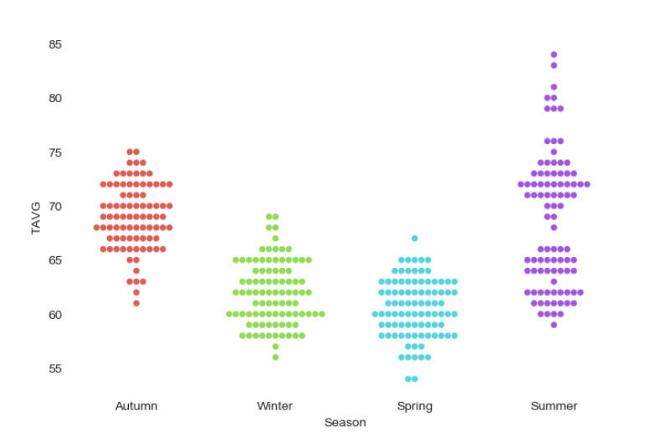
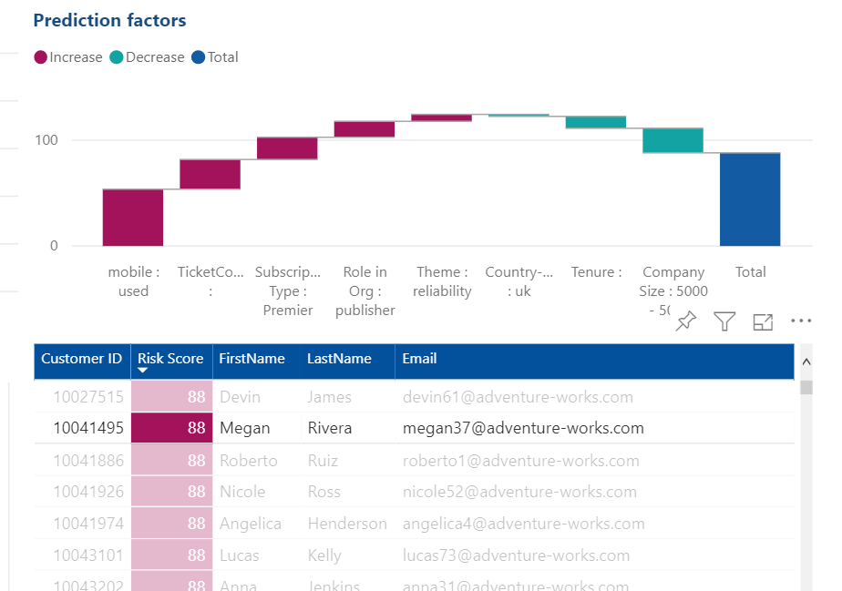
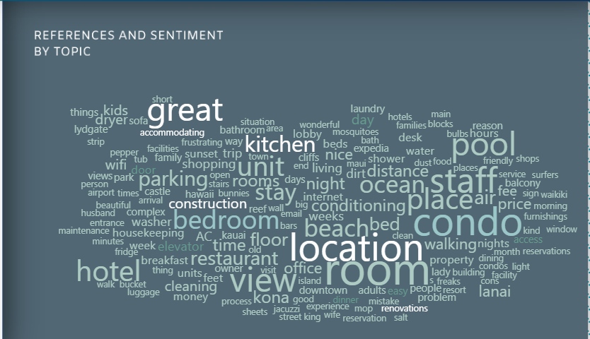
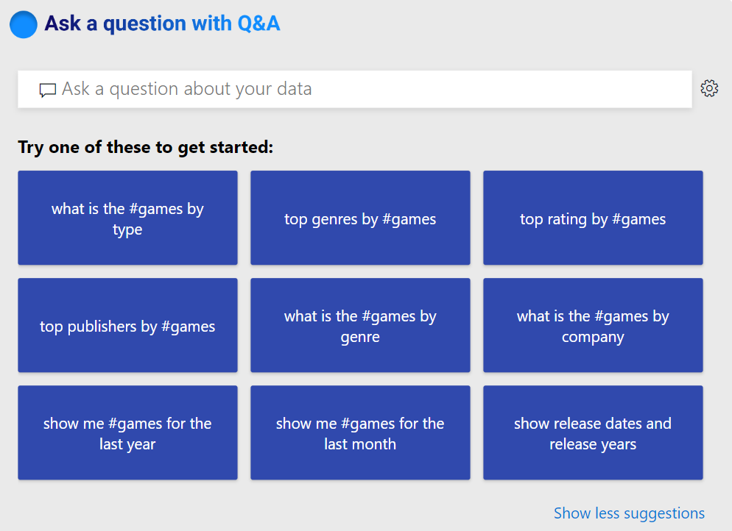

AI in Power BI
Data Scientists
Analysts
End users
Extend with Azure ML
R Integration
Create ML models
Sentiment Analysis
AI Visualizations
Sentiment Analysis
Integrate into reports
Python Integration
Explore predictions
Key Phrase Extraction
Natural Language

Slide 6
AI in Power BI
Data Scientists
Analysts
End users
Extend with Azure ML
R Integration
Create ML models
Sentiment Analysis
AI Visualizations
Sentiment Analysis
Integrate into reports
Python Integration
Explore predictions
Key Phrase Extraction
Natural Language

Slide 7

Demo: AI Visuals

Slide 8
AI in Power BI
Data Scientists
Analysts
End users
Extend with Azure ML
R Integration
Create ML models
Sentiment Analysis
AI Visualizations
Sentiment Analysis
Integrate into reports
Python Integration
Explore predictions
Key Phrase Extraction
Natural Language

Slide 9
AI in Power BI
Data Scientists
Analysts
End users
Extend with Azure ML
R Integration
Create ML models
Sentiment Analysis
AI Visualizations
Sentiment Analysis
Integrate into reports
Python Integration
Explore predictions
Key Phrase Extraction
Natural Language

Slide 10

Demo: Automated ML

Slide 11
Key Takeaways – AutoML
Power BI + Automated ML enables you to:
Automate most of the standard machine learning practices in a non-intrusive yet transparent way
AI in Power BI is not only about achieving great accuracy but about easy translating this accuracy to business impact

Slide 12
Key Takeaways – AutoML
Automated ML in Power BI | Automated ML in Azure
Designed for the business analyst/BI professional | Designed for for the data scientist/data engineer
Skillset required is Power Query and Power BI dataflows (OOB point and click functions, M code) | Skillset required is Azure, Python and Jupyter notebooks
ML model lives completely inside Power BI and can only be used by Power BI | ML model lives in Azure and can be consumed as a webservice by lots of different applications (including Power BI)
Requires Power BI Premium and utilizes capacity | Requires an Azure subscription and utilizes Azure consumption

Slide 13

Demo: Cognitive Services

Slide 14
Key Takeaways – Cognitive Services
Cognitive services in Power BI | Cognitive services in Azure
Designed for the business analyst/BI professional | Designed for for the data scientist/data engineer
Skillset required is Power Query and Power BI dataflows (OOB point and click functions, M code) | Skillset required is Azure, coding language (C#, Java, Node.js, Python)
Lives completely inside Power BI and can only be used by Power BI | Live in Azure and can be consumed as a webservice by lots of different applications
Require Power BI Premium and utilizes capacity | Require an Azure subscription and utilizes Azure consumption

Slide 15
Session takeaways
Power BI + AI enables:
Findings insights seamlessly and interacting with data in a natural way using language
Gives analysts the opportunity to enrich their data using AI and build their own machine learning model without writing any code
Extension points for data scientists to plug in their Python/R scripts or to bring in machine learning models they created elsewhere

Slide 16
Call to Action
Try some of our quick start guides to get started with Automated ML, Cognitive Services and Azure ML on dataflows:
https://docs.microsoft.com/en-us/power-bi/service-machine-learning-automated
Download the latest Power BI Desktop to try AI Visuals
https://powerbi.microsoft.com/en-us/desktop/
Get in touch with the team to talk to us about your use cases, pain points, roadmap feedback (seriously we love hearing from you ☺):
Mitul.rana@gmail.com

Slide 17
Any Questions?

Slide 18
Build Powerful reports using DAX functions in Microsoft Power BI
Bijay Kumar Sahoo
(MVP) Co-Founder TSInfo Technology

